Slide 1
Digital Signature
Dr. B C Dhara
Department of Information Technology
Jadavpur University

Slide 2
Objectives
Define a digital signature
Define security services provided by a digital signature
Define attacks on digital signatures
Discuss some digital signature schemes including
  RSA, ElGamal, Schnorr, DSS, and elliptic curve
Describe some applications of digital signatures
B C Dhara, Dept. of IT, JU

Slide 3
Introduction
Signature on a document is a sign of authentication
  Document is authentic
A sender ‘X’ sends a message to person ‘Y’
  The receiver needs to check the authenticity of the sender
    Receiver needs to be sure that message comes from right person, not from third person
    The signature procedure can be done electronically, which is known as digital signature
B C Dhara, Dept. of IT, JU

Slide 4
Conventional vs. Digital signature
Conventional signature
Digital signature
A conventional signature is included in the document, it is part of the document
For a conventional signature, when the recipient receives a document, compares the signature on the document with the signature on file
When we sign a document digitally, we send the signature as a separate document
For a digital signature, the recipient receives the message and the signature
  The recipient needs to apply a verification technique to the combination of the message and the signature to verify the authenticity
B C Dhara, Dept. of IT, JU

Slide 5
Conventional vs. Digital signature (contd…)
For a conventional signature, there is normally a one-to-many relationship between a signature and documents
In conventional signature, a copy of the signed document can be distinguished from the original one on file
For a digital signature, there is a one-to-one relationship between a signature and a message
In digital signature, there is no such distinction unless there is a factor of time on the document
B C Dhara, Dept. of IT, JU

Slide 6
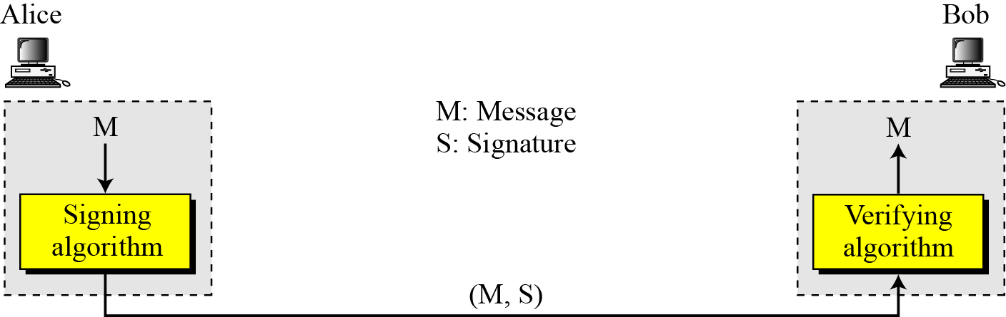
Process
The sender uses a signing algorithm to sign the message
The message and the signature are sent to the receiver
The receiver receives the message and the signature and applies the verifying algorithm to the combination
  If the result is true, the message is accepted; otherwise, it is rejected.
B C Dhara, Dept. of IT, JU

Slide 7
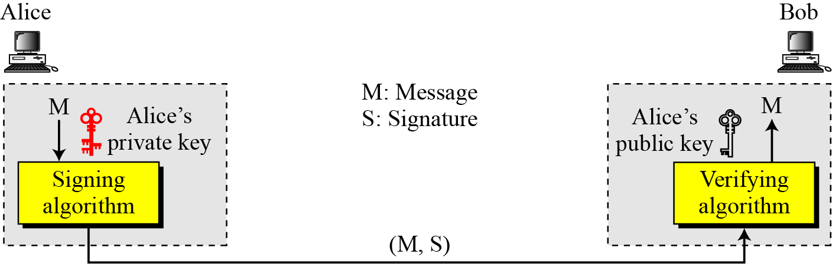
Key in DS
A digital signature uses the private key of the sender in the signing algorithm
The receiver (or verifier) uses the public key of the signer in the verifying algorithm to verify the document
B C Dhara, Dept. of IT, JU

Slide 8
Signing the Digest
Can we use symmetric key in digital signature?
If yes, then for different pair of users, different keys are needed
Also, for different session we may need different key
A cryptosystem uses the private and public keys of the receiver: a digital signature uses
the private and public keys of the sender.
B C Dhara, Dept. of IT, JU

Slide 9
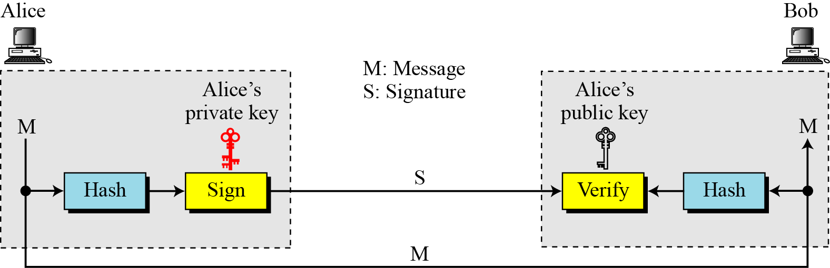
Signing the Digest (contd…)
Asymmetric key is useful technique in digital signature
  Asymmetric key inefficient for long message
  Digital signature system normally handles long message
  Sol: derive a digest of the message (which is normally shorter than message)
    With the assumption of one-to-one relationship between digest and message
  The sender sign on the digest and …
B C Dhara, Dept. of IT, JU

Slide 10
SERVICES
Important concerns of this subject are
  message confidentiality
  message authentication
  message integrity and
  Nonrepudiation
A digital signature can directly provide the last three; for message confidentiality we still need encryption/decryption.
B C Dhara, Dept. of IT, JU

Slide 11
Message authentication
A secure signature scheme (designed with private key of sender) can provide message authentication (data-origin authentication)
Authenticity is verified by the public key of the sender
  Public key of the third person cannot verify the signature
B C Dhara, Dept. of IT, JU

Slide 12
Message Integrity
The integrity of the message is preserved even if we sign the whole message because we cannot get the same signature if the message is changed.
A digital signature provides message integrity.
B C Dhara, Dept. of IT, JU

Slide 13

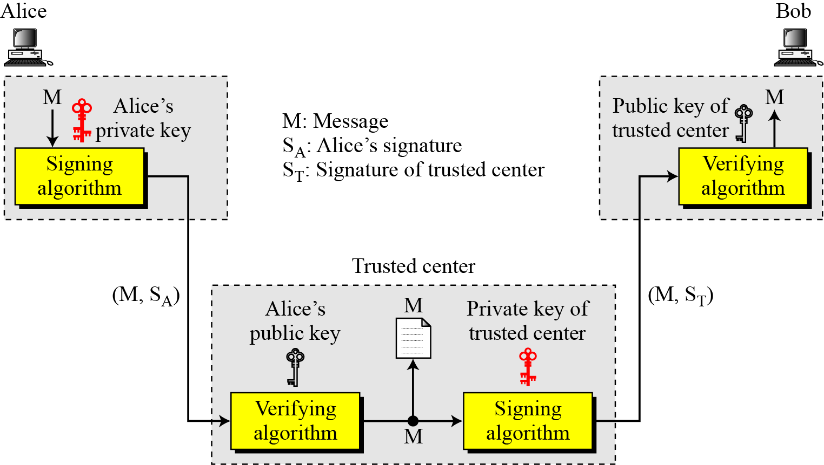
Nonrepudiation
M
Sender identity
Recipient identity
Time stamp
Alice’s identity
Bob’s identity
Sender identity
Recipient identity
Nonrepudiation can be provided using a trusted party
B C Dhara, Dept. of IT, JU

Slide 14
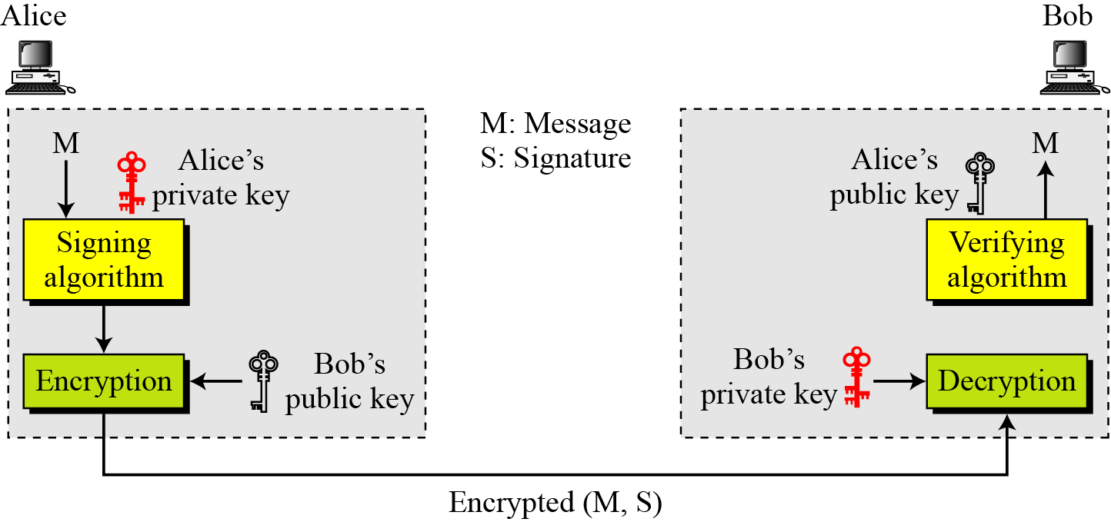
Confidentiality
A digital signature does not provide privacy
If there is a need for privacy, another layer of encryption/decryption must be applied
B C Dhara, Dept. of IT, JU

Slide 15
ATTACKS ON DIGITAL SIGNATURE
This section describes some attacks on digital signatures and defines the types of forgery
Attack types:
  Key only attack
  Known message attack
  Chosen message attack
Forgery types:
  Existential forgery
  Selective forgery
B C Dhara, Dept. of IT, JU

Slide 16
Attacks on digital signatures
Key only attack, attacker can only access public information released by sender. This attack is same as the ciphertext-only attack
Known message attack, attacker has access one or more mewssage-signature pairs. This is similar to the known-plaintext attack
Chosen-message attack, this is similar as chosen-plaintext attack
B C Dhara, Dept. of IT, JU

Slide 17
Types of forgery
If attack is successful, result is a forgery
Existential Forgery: the attacker may be able to compute valid message-signature pair, but cannot be used as content of the document randomly calculated
  Message could be syntactically or semantically unintelligible
Selective Forgery: the attacker may be able to forge sender’s signature of a message
  This may be very hermful to sender
  Probability of such forgery is low, but not negligible
B C Dhara, Dept. of IT, JU

Slide 18
Digital signature schemes
RSA Digital Signature Scheme
ElGamal Digital Signature Scheme
Schnorr Digital Signature Scheme
Digital Signature Standard (DSS)
Elliptic Curve Digital Signature Scheme
B C Dhara, Dept. of IT, JU

Slide 19
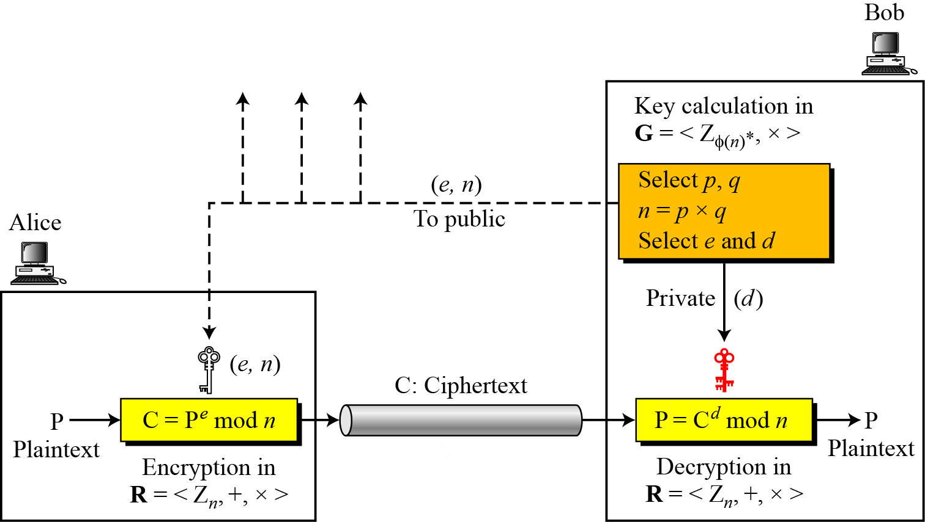
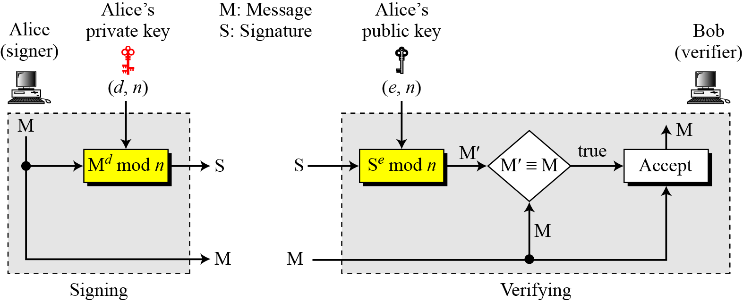
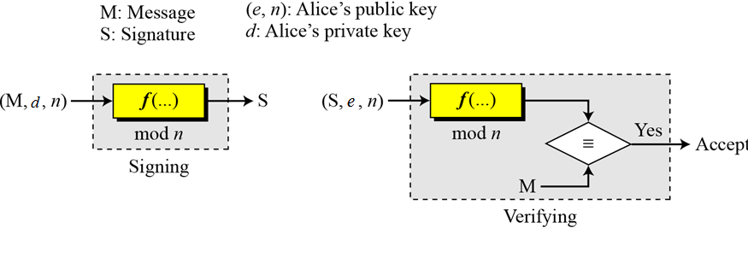
RSA Digital Signature Scheme
RSA Cryptosystem
Private key of the sender used to sign the document
Public key the sender is used to verify the signature
B C Dhara, Dept. of IT, JU

Slide 20
Example: RSA Digital Signature Scheme
As a trivial example, suppose that Alice chooses p = 823 and q = 953, and calculates n = 784319. The value of φ(n) is 782544. Now she chooses e = 313 and calculates d = 160009. At this point key generation is complete. Now imagine that Alice wants to send a message with the value of M = 19070 to Bob. She uses her private exponent, 160009, to sign the message:
Alice sends the message and the signature to Bob. Bob receives the message and the signature. He calculates
Bob accepts the message because he has verified Alice’s signature.
B C Dhara, Dept. of IT, JU

Slide 21
Attacks on RSA Signature
Key only attack: attacker can intercepts (M, S) and try to find another message M’ such that M’≡ S^{e} mod n
  This problem is as difficult to solve discrete logarithm problem
Known-message attack: two message-signature pairs (M1, S1) and (M2, S2), computed by same private key, are intercepted and attacker send (M, S) to receiver to fool-ed him
  M= M1 * M2 mod n and S= S1 * S2 mod n
  This existential forgery, and useless
  This attack known as multiplicative key
B C Dhara, Dept. of IT, JU

Slide 22
Attacks on RSA Signature (contd…)
Chosen plaintext attack: somehow the attacker (Eve) manages sender to sign on two messages M1 and M2
  Later, the attacker may claim that sender has signed on M= M1 * M2, which is a serious problem
  This is a selective forgery
B C Dhara, Dept. of IT, JU

Slide 23
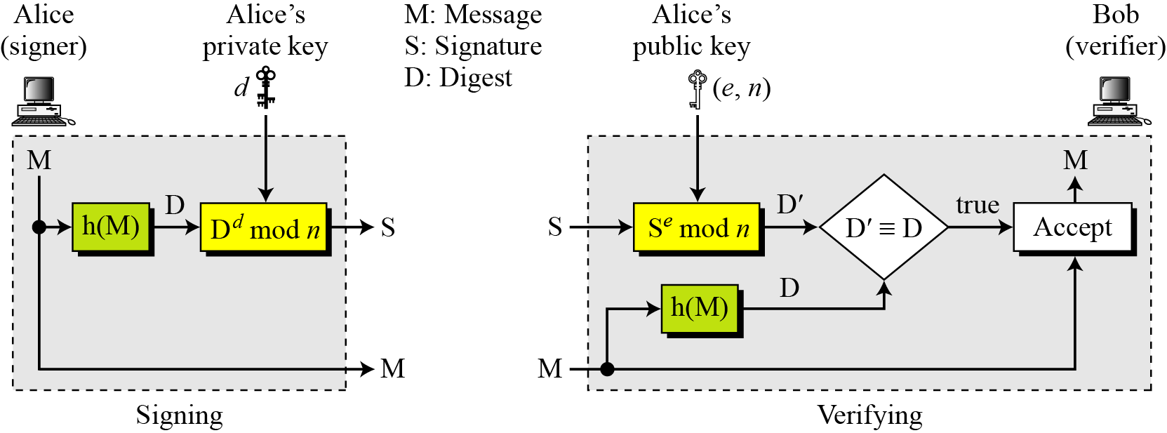
RSA Signature on the Message Digest
Several advantages like: signing and verifying is faster
If a strong cryptographic hash function is used, attack on signature will be more difficult
B C Dhara, Dept. of IT, JU

Slide 24
Attacks on RSA Signed on Digest
The attacks like on RSA signature are possible
When the digest is signed instead of the message itself, the susceptibility of the RSA digital signature scheme depends on the strength of the hash algorithm
B C Dhara, Dept. of IT, JU

Slide 25
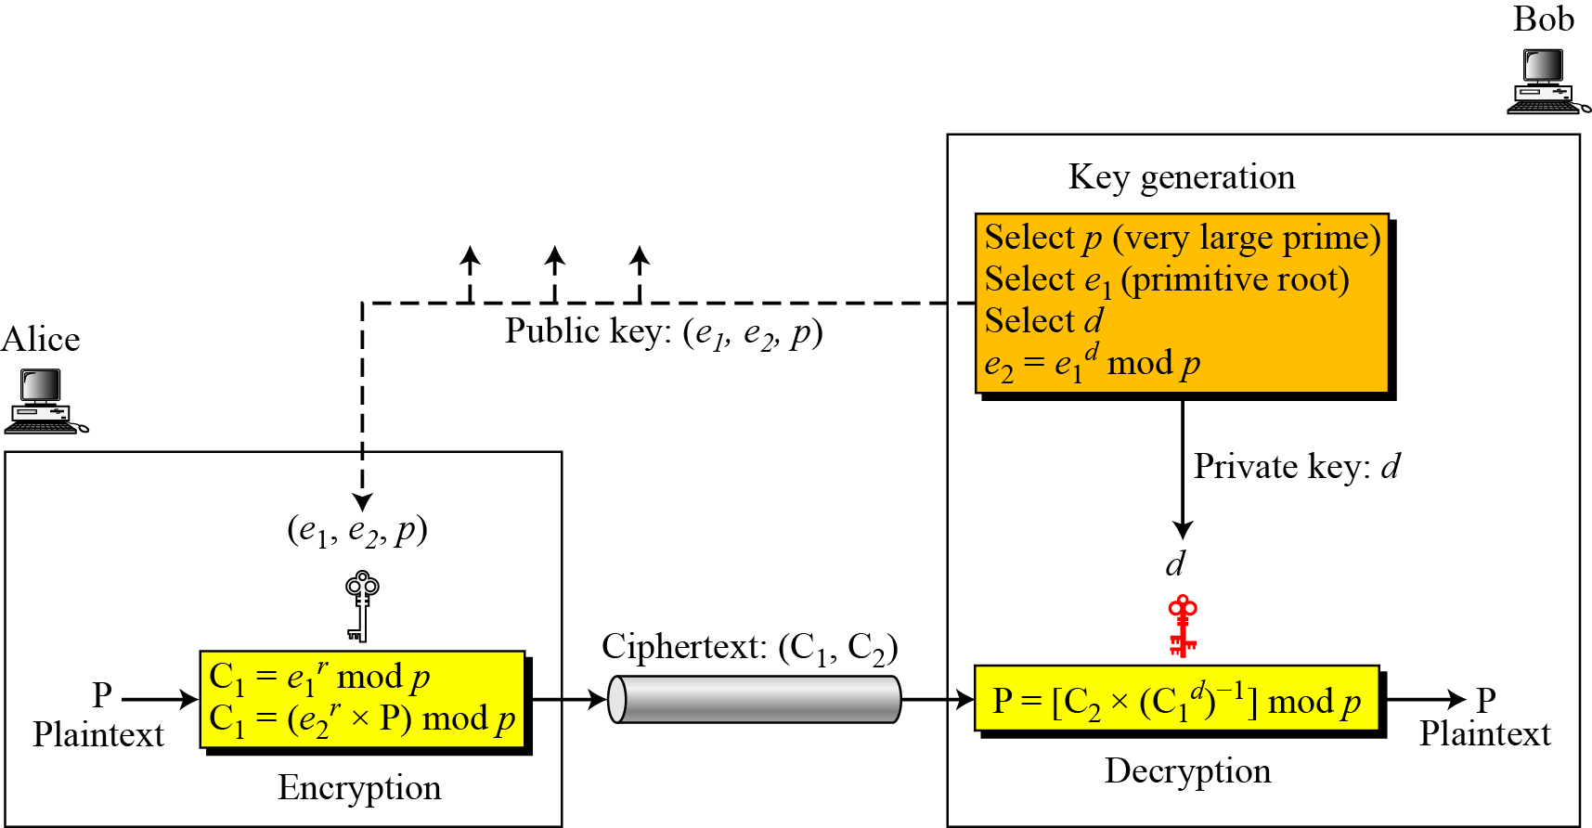
ElGamal Digital Signature Scheme
ElGamal Cryptosystem
d ∈ G=<Z_{p}*,×>, 1≤d≤p-2
e₁ primitive root . in G=<Z_{p}*,×>
B C Dhara, Dept. of IT, JU

Slide 26
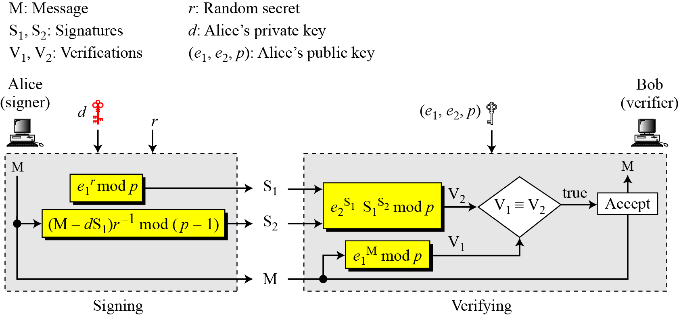
ElGamal Digital Signature Scheme
B C Dhara, Dept. of IT, JU

Slide 27
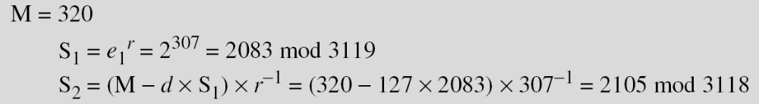
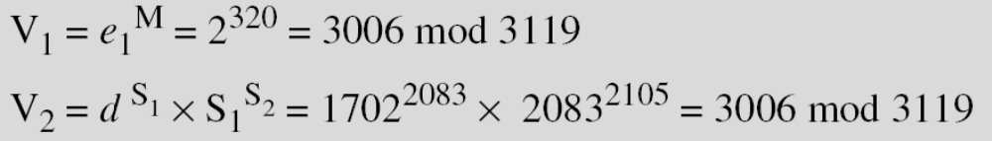
Example: ElGamal Digital Signature
Here is a trivial example. Alice chooses p = 3119, e₁ = 2, d = 127 and calculates e₂ = 2¹²⁷ mod 3119 = 1702. She also chooses r to be 307. She announces e1, e2, and p publicly; she keeps d secret. The following shows how Alice can sign a message.
Alice sends M, S₁, and S₂ to Bob. Bob uses the public key to calculate V₁ and V₂.
B C Dhara, Dept. of IT, JU

Slide 28
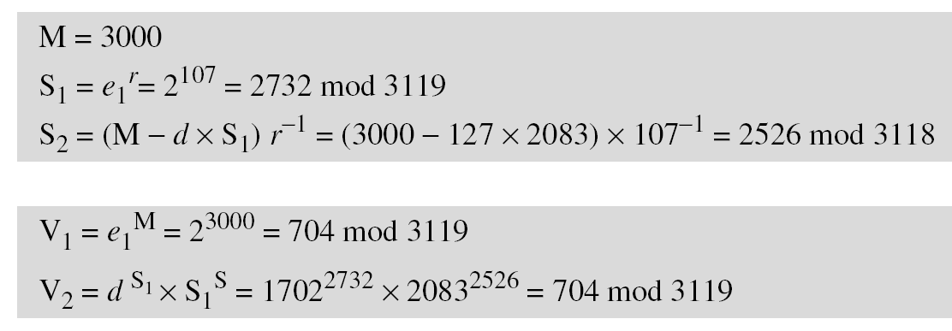
Example: ElGamal Digital Signature
Now imagine that Alice wants to send another message, M = 3000, to Ted. She chooses a new r, 107. Alice sends M, S₁, and S₂ to Ted. Ted uses the public keys to calculate V₁ and V₂.
B C Dhara, Dept. of IT, JU

Slide 29
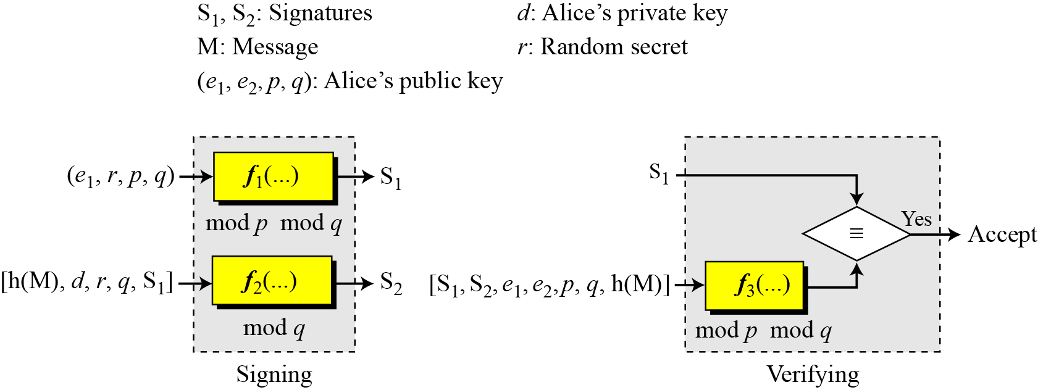
Digital Signature Standard (DSS)
DSS was adopted by NIST in 1994
DSS uses a digital signature algorithm (DSA) based on ELGamal scheme with some idea from Schnorr
General idea behind DSS scheme
B C Dhara, Dept. of IT, JU

Slide 30
Key Generation
Alice chooses primes p, between 512 and 1024 bits and multiple of 64
Choose another prime q of 160 bits and q | (p-1)
Alice uses <Z_{p}*, × > and <Z_{q}*, ×>, second is subgroup of first
Alice chooses e₁ to be the qth root of 1 modulo p
  For a primitive element e₀ in Z_{p}, e₁= e₀^{(p-1)/q} mod p
Alice chooses an integer, d, as her private key
Alice calculates e₂ = e₁^{d} mod p
Alice’s public key is (e₁, e₂, p, q); her private key is (d).
B C Dhara, Dept. of IT, JU

Slide 31
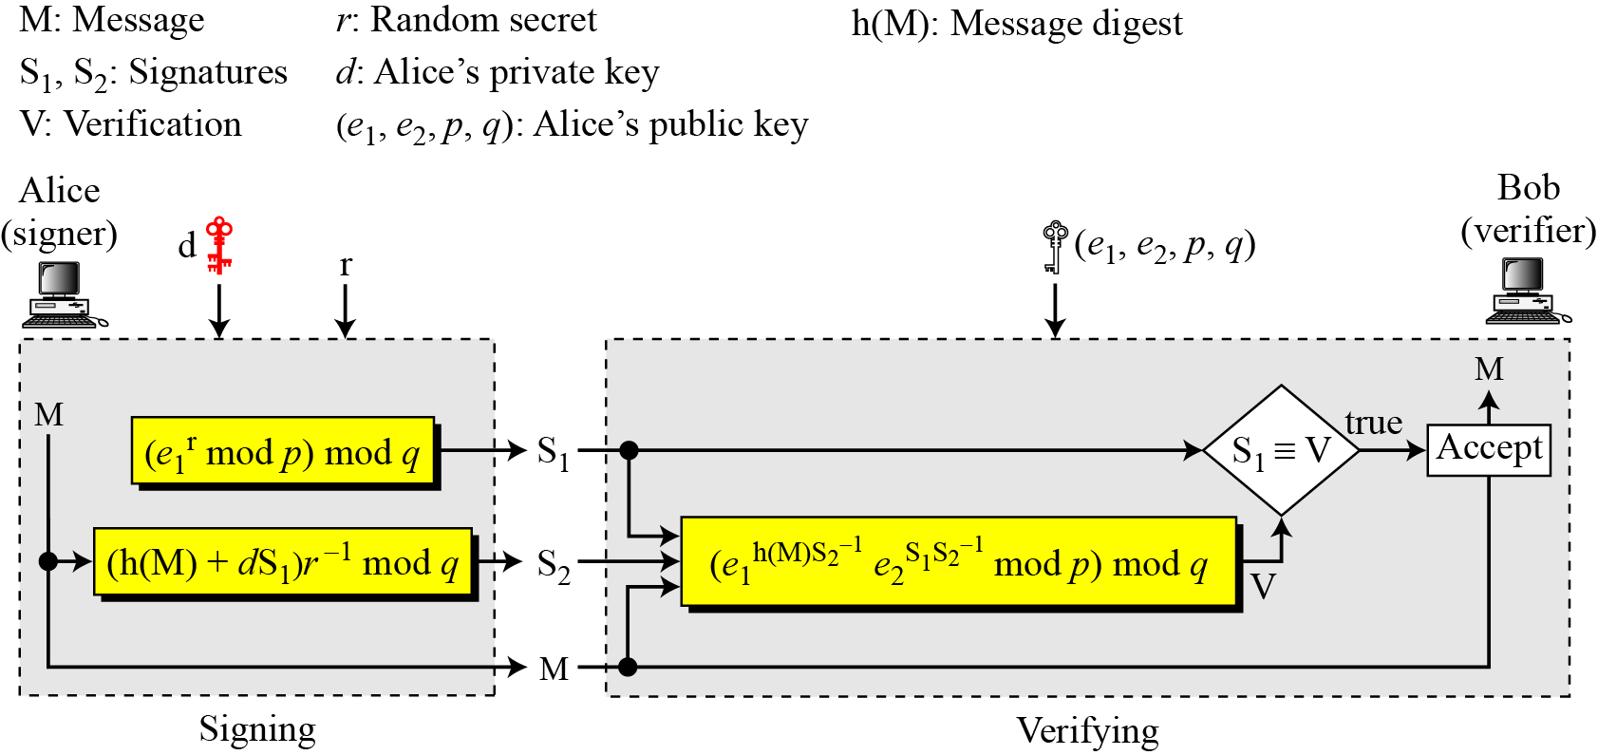
Verifying and Signing
B C Dhara, Dept. of IT, JU

Slide 32
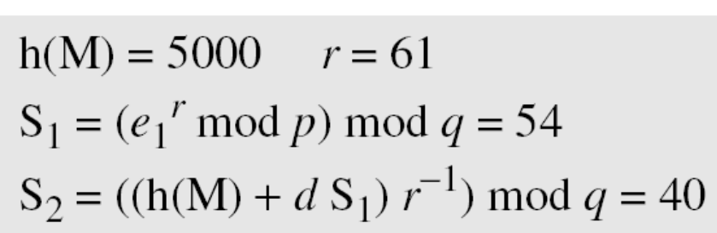
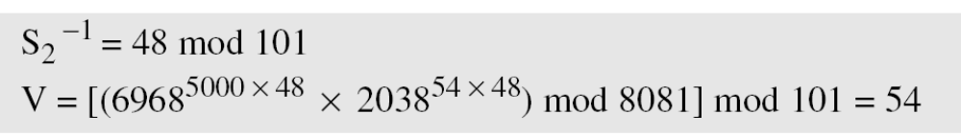
Example: DSS
Alice chooses q = 101 and p = 8081. Alice selects e₀ = 3 and calculates e¹ = e₀ ^{(p−1)/q} mod p = 6968. Alice chooses d = 61 as the private key and calculates e₂ = e₁^{d} mod p = 2038. Now Alice can send a message to Bob. Assume that h(M) = 5000 and Alice chooses r = 61:
Alice sends M, S₁, and S₂ to Bob. Bob uses the public keys to calculate V.
B C Dhara, Dept. of IT, JU

